Slide 1
Crafting a Life of Greater Well-Being
Paulette Risher
Major General, U.S. Army (retired)
Learning for the Journey, LLC
paulette@learningforthejourney.com

Slide 2
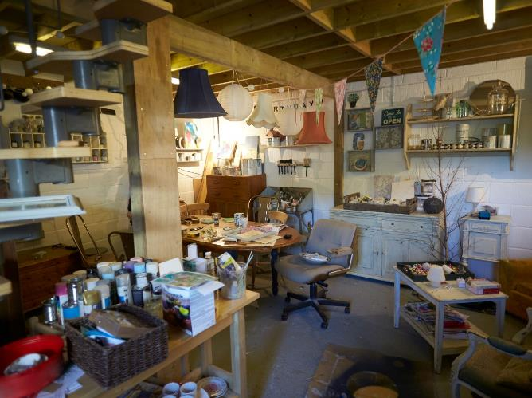
Topics
Stage setting
Science & Practice of Well-Being
The Obstacles to Well-Being
Crafting a Life of Greater Well-Being
Process and Mindset
Self-Assessment
Practical Advice
Questions and Discussion

Slide 3
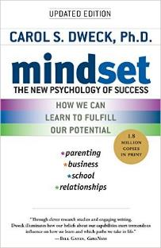
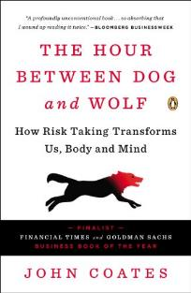
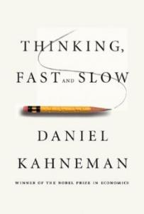
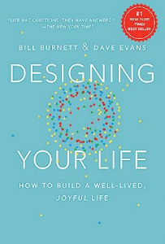
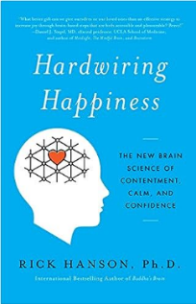
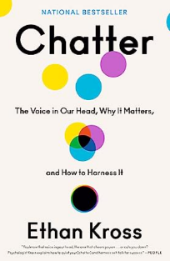
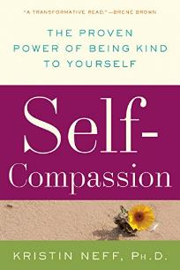
Sources of Ideas

Slide 4
The Science and Practice of Well-Being

Slide 5
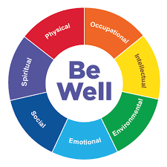
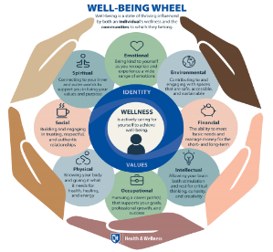
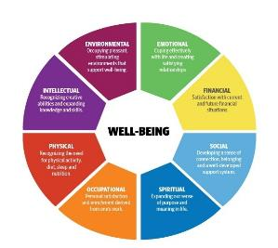
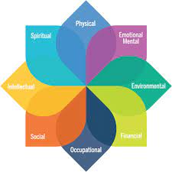
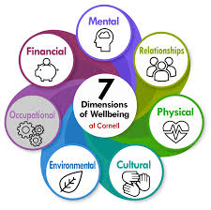
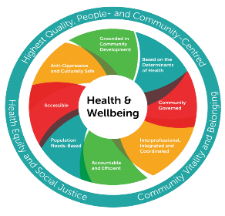
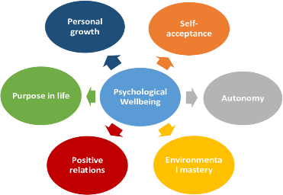
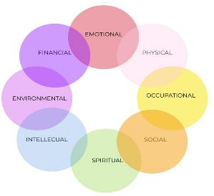
Well-Being: Many Models
Commonality: Well-Being is multidimensional, and those dimensions are interrelated!

Slide 6
Well-Being: Government
Physical well-being
Economic well-being
Social well-being
Development and activity
Emotional well-being
Psychological well-being
Life satisfaction
Domain specific satisfaction
Engaging activities and work

Slide 7
Well-Being: Popular Press
Well-being is the experience of health, happiness, and prosperity
It includes having good mental health, high life satisfaction, a sense of meaning or purpose, and the ability to manage stress
More generally, well-being is just feeling well

Slide 8
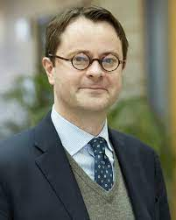
Well-Being: Academia
The five domains of human flourishing:
Happiness and life satisfaction
Mental and physical health
Meaning and purpose
Character and virtue
Close social relationships
Dr. Tyler VanderWeele
Notes:
Dr. Tyler VanderWeele – Program Director

Slide 9
Consider the Building Blocks
10 “Building Blocks” of Well-Being
Altruism
Awe
Bridging Differences
Compassion
Diversity
Empathy
Forgiveness
Gratitude
Happiness
Intellectual Humility
Mindfulness
Purpose
Dr. Dacher Keltner

Slide 10
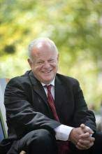
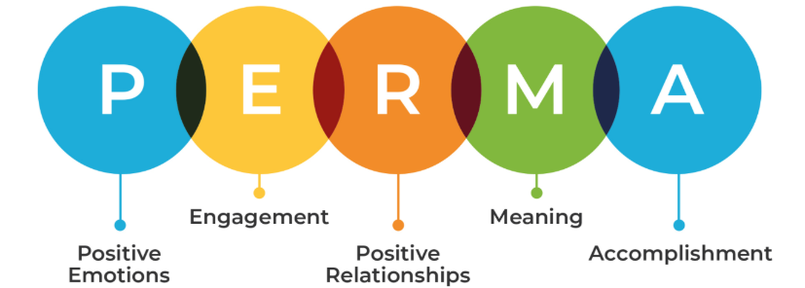
Well-Being: Academia
Positive Emotions
Engagement
Positive Relationships
Meaning
Accomplishment
Dr. Martin Seligman

Slide 11
Well-Being: Research
Psychological Well-Being
Feeling good – positive emotions i.e., happiness and contentment, interest, engagement, confidence, and affection
Functioning effectively (in psychological sense) - developing one’s potential, having some control over one’s life, have a sense of purpose (working towards valued goals) and experiencing positive relationships
Recognizing that this is not happiness everyday but managing the negative or painful emotions that are a part of normal life
Psychological Well-being: Evidence Regarding its Causes and Consequences (Felecia Huppert)

Slide 12
Well-Being: Common Components
Social Connection
Emotional
Financial
Health
Spiritual
Work & Contribution
Living Conditions
Intellectual Engagement
Risher’s Perspective: While the components are “common,” the definitions and priorities are unique to who we are and where we are in our lives

Slide 13
The Obstacles to Well-Being

Slide 14
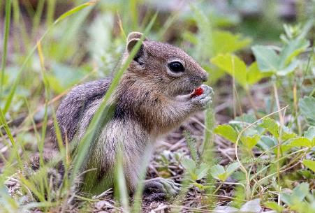
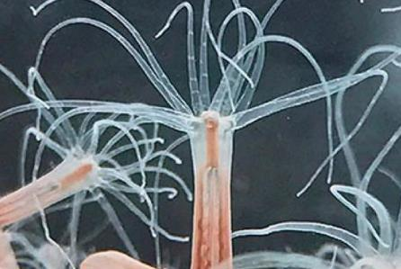
Number One Obstacle: Our Biology!
Survival Imperative: Eat and Don’t Be Eaten!
From the 800 million year ago Starlet Sea Anemone to 8 billion modern humans!

Slide 15
Our “Two System Brain”
System 1 – Right Hemisphere
System 2 – Left Hemisphere
Intuition & Instinct
Subconscious and fast
Seat of beliefs, emotions, habits, values, intuition, imagination, connects new learning with old
Non-verbal
Automates much of daily life
Always “on” 24/7
Scans for “danger” (physical or psycho-social) and alerts us to fight, flee, or freeze
Manages scarce mental energy by streamlining decision
Executive Thinking
Conscious and slow
Seat of higher-order reasoning, emotional intelligence, feelings, and “adult” behavior
“Smart – but small, sequential, and slow”
Heavily dependent on working memory only 3-4 “chucks” at a time
Seat of willpower and decision making
Easily distracted
Easily tired
90%
10%
Autopilot | Guardian |
Dot Connector | Energy Manager
Higher Order Thinker |
Adult | Planner | Social and Emotional Navigator
The Mammalian Operating System
The Executive Adult

Slide 16
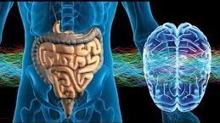
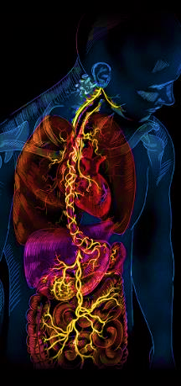
The “Brain” in the Gut
The gut has a mind of its own, the "enteric nervous system”
This system sends and receives impulses, records experience and responds to emotions
The gut contains 100 million neurons - more than the spinal cord and about the same as our dog’s brain
Its nerve cells are bathed and influenced by the same neurotransmitter drugs
The vagus nerve connects the brain in the head with the gut; 80% of connections are bi-directional

Slide 17
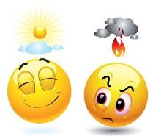
The Brains “Chemical Soup”
Pleasure
Fight, Flee, Freeze
Endorphin – Runner’s high, released in response to stress and pain, services to mask the pain
Dopamine – Generates good feeling for finding something we have sought after or satisfaction for task accomplished
Serotonin – Feeling of pride
Oxytocin – Social feelings of friendship, love, trust
Adrenaline – under conditions of threat (real or not), redirects blood flow, and carbohydrate metabolism
Noradrenaline/ Norepinephrine – prepares muscles and heart for response to acute threat
Cortisol – the primary stress hormone, increases glucose in the bloodstream, enhances your brain's use of glucose and prepares body to repair tissues

Slide 18
Example: Response Sequence
Challenging Event(s)
Financial pressure & uncertainty
Toxic politics
Social challenges
24-hours news and social media
Random acts of violence
Loss of a loved one
Natural disasters
Technology threats
International Conflicts
COVID -19
Our Human Response
24/7 alert
Fight, flight, or freeze response
Vison narrowed
Higher order reasoning diminished
Social and emotional navigation impaired
“Adult” response is degraded
Long-term stress hormones i.e., cortisol can lead to:
Anxiety
Depression
Digestive problems
Headaches
Heart disease
Sleep problems
Weight gain
Memory and concentration impairment
The Default Lived Experience
Fearful, negative, reactive, unsettled, isolated
Hunkered down
“So fast are our reactions that consciousness is frequently left out of the loop.” (John Coates)

Slide 19
Our Negativity Bias
We are negative by nature!
Our biology evolved to keep us safe, not happy (Rick Hanson)
The mind is like Velcro for negative experiences, positive experiences are like Teflon (Rick Hanson)
Adults display a negativity bias, or the propensity to attend to, learn from, and use negative information far more than positive information (Amrisha Vaish)
Painful experiences are much more memorable than pleasurable ones
Negativity is emotionally contagious
It takes ~5 positive experiences to 1 negative to be “flourishing” (Barbara Frederickson)

Slide 20
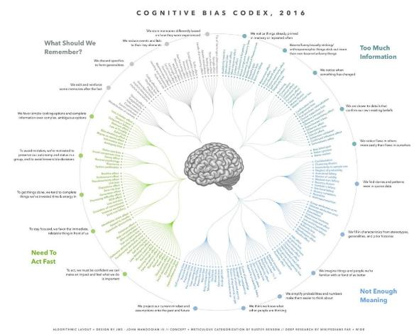
Our Thinking is Habitually Hijacked
Automatic, subconscious brain uses mental shortcuts – heuristics - to save energy
Used when we need to act fast, have too much or too little information, or when we are tired, distracted, overwhelmed
Cognitive bias are “normal,” self-protective, and mostly helpful
Don’t trust your first solution – it is typically wrong/incomplete
Individually and collectively, we have “habitual” bias which seem “common sense” but can lead us astray when we have to decide
Ask yourself … “what could I do?” not “what should I do?”
Cognitive Bias Codex by John Manoogian III

Slide 21
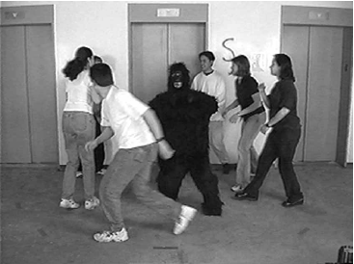
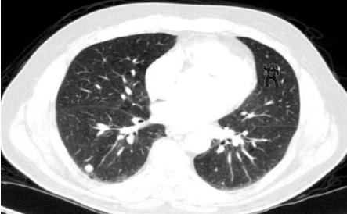
We Can’t See Without Intention
“The human brain has evolved to hide from us those things we are not paying attention to” (Daniel Levitin)
Human retina transmits to the brain approximately 10 million bits of info per second; other senses add 1 million bits per second - only 40-50 bits per second reach our consciousness
When tasked-focused, the automatic system filters out anything that is not relevant
When observers were tasked to count basketball passes among specific players, 50% didn’t see the woman in the gorilla suit (Daniel Simons)
A gorilla, 48 times larger than the average nodule, was inserted in the last case. 83% of radiologists did not see the gorilla (Trafton Drew)

Slide 22
We Chatter and Listen
“We talk to ourselves. And we listen to what we say.”
Our inner voice is active about 50% of our waking hours
The inner voice is a basic feature of the mind. It enables us:
Be introspective and pay attention to our own thoughts and feelings
To demonstrate self-control
To set, strive for, evaluate progress toward goals
To run mental simulations and “what if’s”
To navigate and “storify” everyday life
To inform “the most foundational psychological story of all: our identities”
33-50% of our waking hours are not living in the present moment
We talk to ourselves at a rate equivalent to 4,000 words per minute (and that is not a typo)

Slide 23
We Chatter and Listen
“The inner voice is vulnerable to being hijacked by chatter
Chatter often is triggered “when our stress is up, when the stakes are high, when we encounter difficult emotions that call for the utmost poise”
Chatter can be…
“Rambling soliloquy”
A dialogue we have with ourselves
Compulsive rehashing of past events (rumination)
Angst-ridden imaging of future events (worry)
Sometimes a free-associative pinballing between negative feeling and ideas
Sometimes it’s a fixation on one specific unpleasant feeling or notion”
When chatter takes over “our mind not only torments but paralyzes us. It can also lead us to do things that sabotage us.”

Slide 24
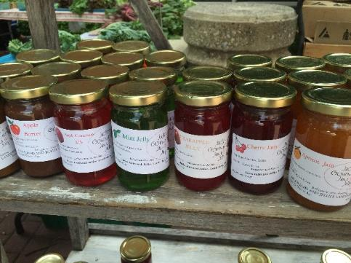
We Get Overloaded by Choice
We love having choices! Options and alternatives are highly valued
However, too many choices can result in “choice overload”
“Choice overload” can negatively impact decision making and decision satisfaction
Sheena Iyengar and Mark Lepper presented shoppers in a specialty food store the opportunity to sample jam and then measured actual purchases. These are the results:
Jam Varieties | % Sampled | % Purchased
24 | 60 | 3
6 | 40 | 30
Good decisions involve both option exploration and the narrowing of options
What are the boundaries of an acceptable decision?

Slide 25
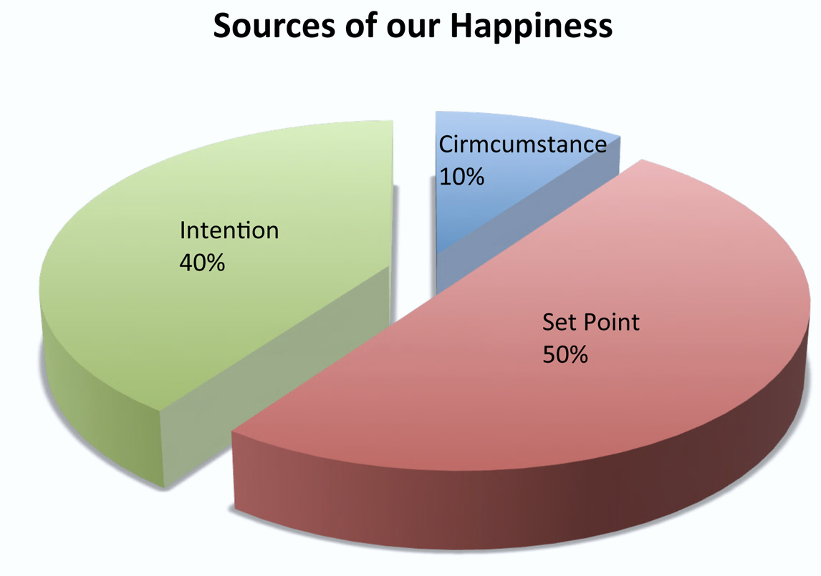
Happiness as “Subjective Wellbeing”
Happiness is on average about 50% genetic setpoint and 10% life circumstance. We can intentionally address the remaining 40%!
Risher’s Perspective: No one can make us happy. We have to believe that we can be happier and that this is “ours to do.”

Slide 26
Crafting a Life of Greater Well-Being as Process

Slide 27
Life Crafting - Process & Mindset
Start Here
Personalize
The Craftsman’s Mindset:
This work is close-up and hands-on
Messiness and imperfection are the norm
Mastery comes from practice
Not everyone will love what you create – nor do they have to!
Savor & Celebrate
Evaluate
Track &Tinker
Clarify & Prioritize
Connect
Strategize & Start
Seven Steps for
Crafting a Life of
Greater Well-Being

Slide 28
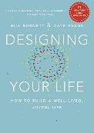
Personalize and Evaluate
1
2
The Well-Being Dashboard
 |  | How full is your tank? ***
Common Categories of Well-Being * | My Preferred Labels ** | Empty |  |  | Full
Emotional | Emotional
Environmental | Living Conditions
Financial | Money
Intellectual | Interests and Learning
Occupational | Professional Contribution
Physical | Health
Social | Connection
Spiritual | Spiritual
* Alphabetical – not by importance
** Use words that have meaning for you at this point in your life!
*** Adapted from: Designing Your Life: How to Build a Well-Lived, Joyful Life
Bill Burnett and Dave Evans

Slide 29
Personalize and Evaluate
1
2
The Well-Being Dashboard |  | How full is your tank?
Common Categories of Well-Being | Personally Meaningful Labels | Empty |  |  | Full | The “Why” in Shorthand
Emotional
Environmental
Financial
Intellectual
Occupational
Physical
Social
Spiritual

Slide 30
Clarify & Prioritize
3
Which element(s) is/are – from your perspective – the most problematic in your life today?
Which is/are the most beneficial and need to be protected?
In your own words, what one change could most impact your well-being and life?
–

Slide 31
Strategize & Start
4
Outline a realistic plan to address the “one thing.”
What steps can you take now?
What is reasonable given the demands of your life?
–

Slide 32
Connect for Support
5
Seek out supporters and kindred souls
Avoid the cynics and judgers
You don’t have to do this alone – but you can and may choose to!

Slide 33
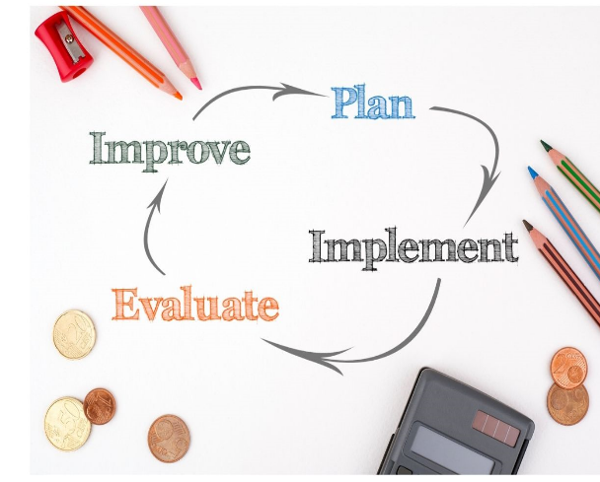
Track & Tinker
6
Continually assess what is working and what is not
Continually improve your craft/life!

Slide 34
Savor and Celebrate!
7
Take the time and really experience the sense of taking “ownership” for increasing the well-being in your life
“Wash, Rinse, Repeat” !

Slide 35
Practical Advice

Slide 36
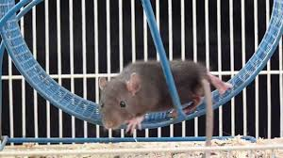
Get Off the Rat Wheel!
Create quiet time for personal thinking
Find a quiet space
Get your thoughts out of your head and onto paper or electrons
Relax and take a deep breath
Speak kindly to yourself – be gentle in word and deed

Slide 37
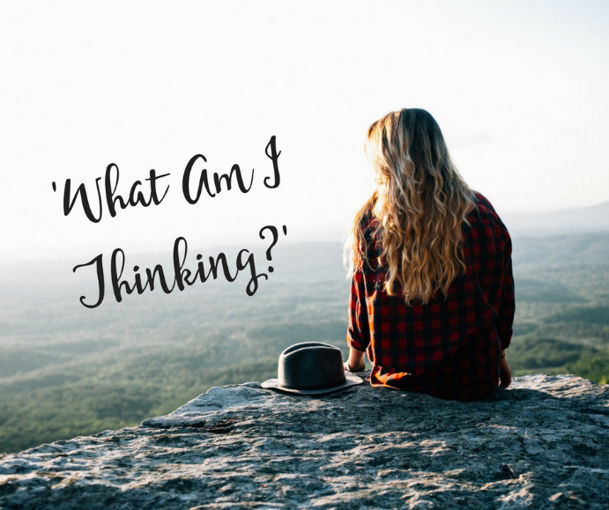
Listen to Your Own Voice
Make this private and personal work
Share when ready – but not prematurely and then only with those with a “need to know”
Seek advice judicially
Set aside the din of social media and “experts”

Slide 38
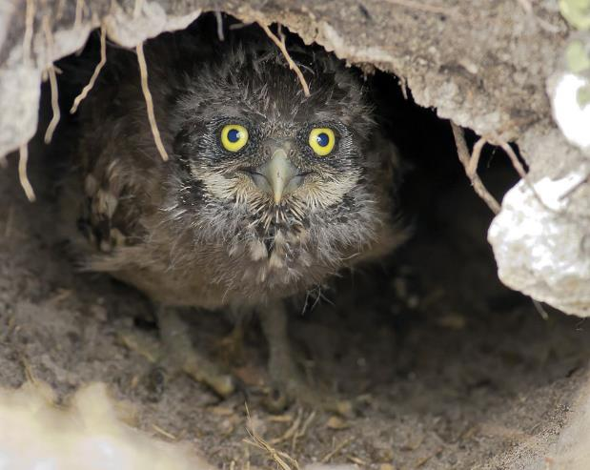
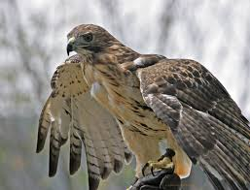
Be Not Afraid – It’s a Choice
We can accept the default and hunker down – fearful, negative, reactive, unsettled, and isolated
We can seek and claim our own well-being and happiness –
with intention, attention, and effort
or

Slide 39
Be Not Afraid…continued
Think of this as exploratory – you don’t have to do anything of this – the choice is yours
Open the lens wide and look deeply – but then narrow the field to the manageable and meaningful few items
Have confidence in yourself (i.e., self-efficacy/ internal locus of control)
Focus on what you can control and influence in your personal life – let go of the rest!
Circle of Control
Circle of Influence
Circle of Interest/Concern

Slide 40
Practice Self-Compassion
Three Key Elements
1. Self-kindness
“that we be gentle and understanding with ourselves rather than harshly critical and judgmental”
“We make a peace offering of warmth, gentleness, and sympathy from ourselves to ourselves, so that true healing can occur.”
Four Question from Dr. Marshall Rosenberg…
What am I observing?
What am I feeling?
What am I needing right now?
Do I have a request of myself or someone else?
“We don’t need others to respond with care and compassion in order to feel worthy of love”
Dr. Kristin Neff
University of Texas at Austin

Slide 41
Practice Self-Compassion
2. Common humanity
“feeling connected with others in the experience of life rather than feeling isolated and alienated by our suffering”
“mutuality in the experience of suffering… and we remember that feelings of inadequacy and disappointment are shared by all”
“Whereas self-pity says ‘poor me,’ self-compassion remembers that everyone suffers, and it offers comfort because everyone is human.”
“When we remember that pain is part of the shared human experience, we escape from the rabbit hole of self-pity”

Slide 42
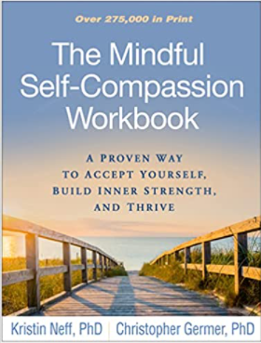
Practice Self-Compassion
3. Mindfulness
“To give ourselves compassion, we first have to recognize that we are suffering. We can’t heal what we can’t feel”
When life goes wrong through no fault of our own, we don’t necessarily blame ourselves, but “go immediately into problem-solving mode”. “We need to acknowledge that we’re having a hard time, and that our pain is deserving of a kind response”

Slide 43
Establish the Foundation
Resilience. Resilience is the rapidity with which we recover from adversity;
Outlook. the ability to see the positive in others, the ability to savor positive experiences, the ability to see another human being as a human being who has innate basic goodness.
Attention. “A wandering mind is an unhappy mind.”
What are you doing right now?
Where is your mind right now?
Is it focused on what you’re doing, or is it focused elsewhere?
How happy or unhappy are you right now?
Generosity. when individuals engage in generous and altruistic behavior, they actually activate circuits in the brain that are key to fostering well-being.
Dr. Richard Davidson

Slide 44
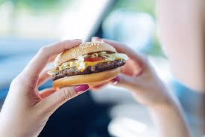
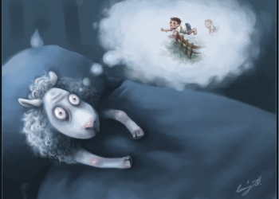
Take Care of Yourself!
Good self-care enables a life of greater well-being
Distraction, worry, sleep deprivation, and “fast food” lifestyle are not a Rx for well-being or a well-crafted life!

Slide 45
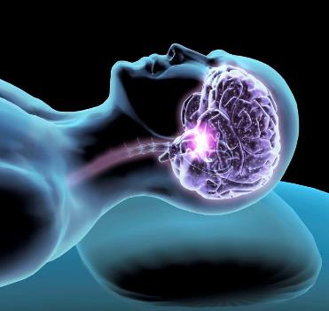
Take Care of Yourself!
Sleep is not a luxury…
During sleep, new learnings are linked with older information
The deliberate, higher order side of the brain needs rest time
The automatic, associative brain works 24/7 and can search for solutions and answers while asleep
Sleep deprivation lowers immunity
50-70M American adults have a sleep disorder
Over 30% of Americans are sleep deprived!

Slide 46
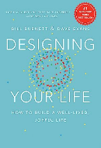
Additional Resources
The Values in Action (VIA) Survey of 24 Character Strengths (https://www.viacharacter.org/) (free!)
The Greater Good Science Center (https://greatergood.berkeley.edu/)
CALM App – for mindfulness and meditation
Designing Your Life by Barnett & Evans

Slide 47
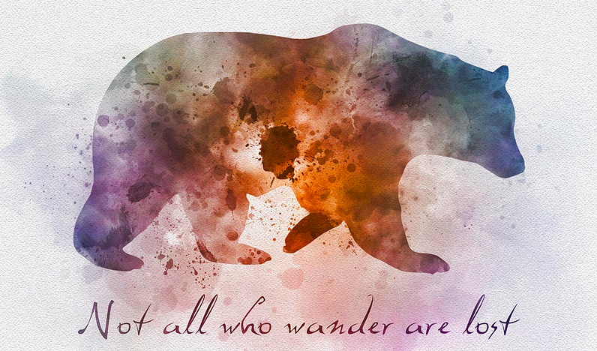
Paulette Risher
256.771.3868
Paulette@LearningfortheJourney.com
https://www.learningforthejourney.com/

Slide 48
Back-Up Information
Start Here
Personalize
Savor & Celebrate
Evaluate
Track &Tinker
Clarify & Prioritize
Connect
Strategize & Start

Slide 49
Life Crafting Process: The Details
1
2
3
Personalize
What do each of the elements of well-being mean to you – today? Use your own words!
Evaluate
Where are you today in each of the elements of well-being? Overall?
Clarify & Prioritize
Which of the element(s) is/are in most need of attention? Which ones need to be protected? What one change could most impact your well-being & life?
6
5
4
Track & Tinker
Continually assess what is working and what is not. Continually improve your craft/life.
Connecting for Support
Seek out supporters and kindred souls. Avoid the cynics and judgers. You don’t have to do this alone - but you can and may choose to.
Strategize
Outline a realistic plan to address the “one thing.” What steps can you take now? What is reasonable given the demands of your life?
7
Savor and Celebrate!
Take the time and really experience the sense of taking “ownership” of your life! It is your life and put your “stamp ” on it!

Slide 50
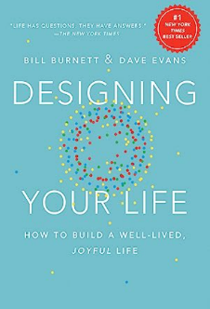
Five Keys to “Life Design”
Be Curious. Ask questions. Wonder why. Explore
Try Stuff. Bias to action. Prototype and experiment. Move beyond just thinking and planning and talking
Reframe Problems. Step back and look at problems in different ways. Are you working on the right problem? Examine the underlying assumptions. Get unstuck
Know it’s a Process. Life is messy. Life is a journey. Mistakes are a part of life. “Let go of the end-goal and focus on the process and what happens next”
Ask for Help. You don’t have to have all of the answers yourself.
Designing Your Life: How to Build a Well-Lived Joyful Life (2016)

